Slide 1
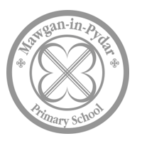

Early Years and Key Stage
1 Reading and Writing Workshop
‘The more you read, the more things you will know. The more that you learn, the more places you’ll go’
Dr Seuss.

Slide 2
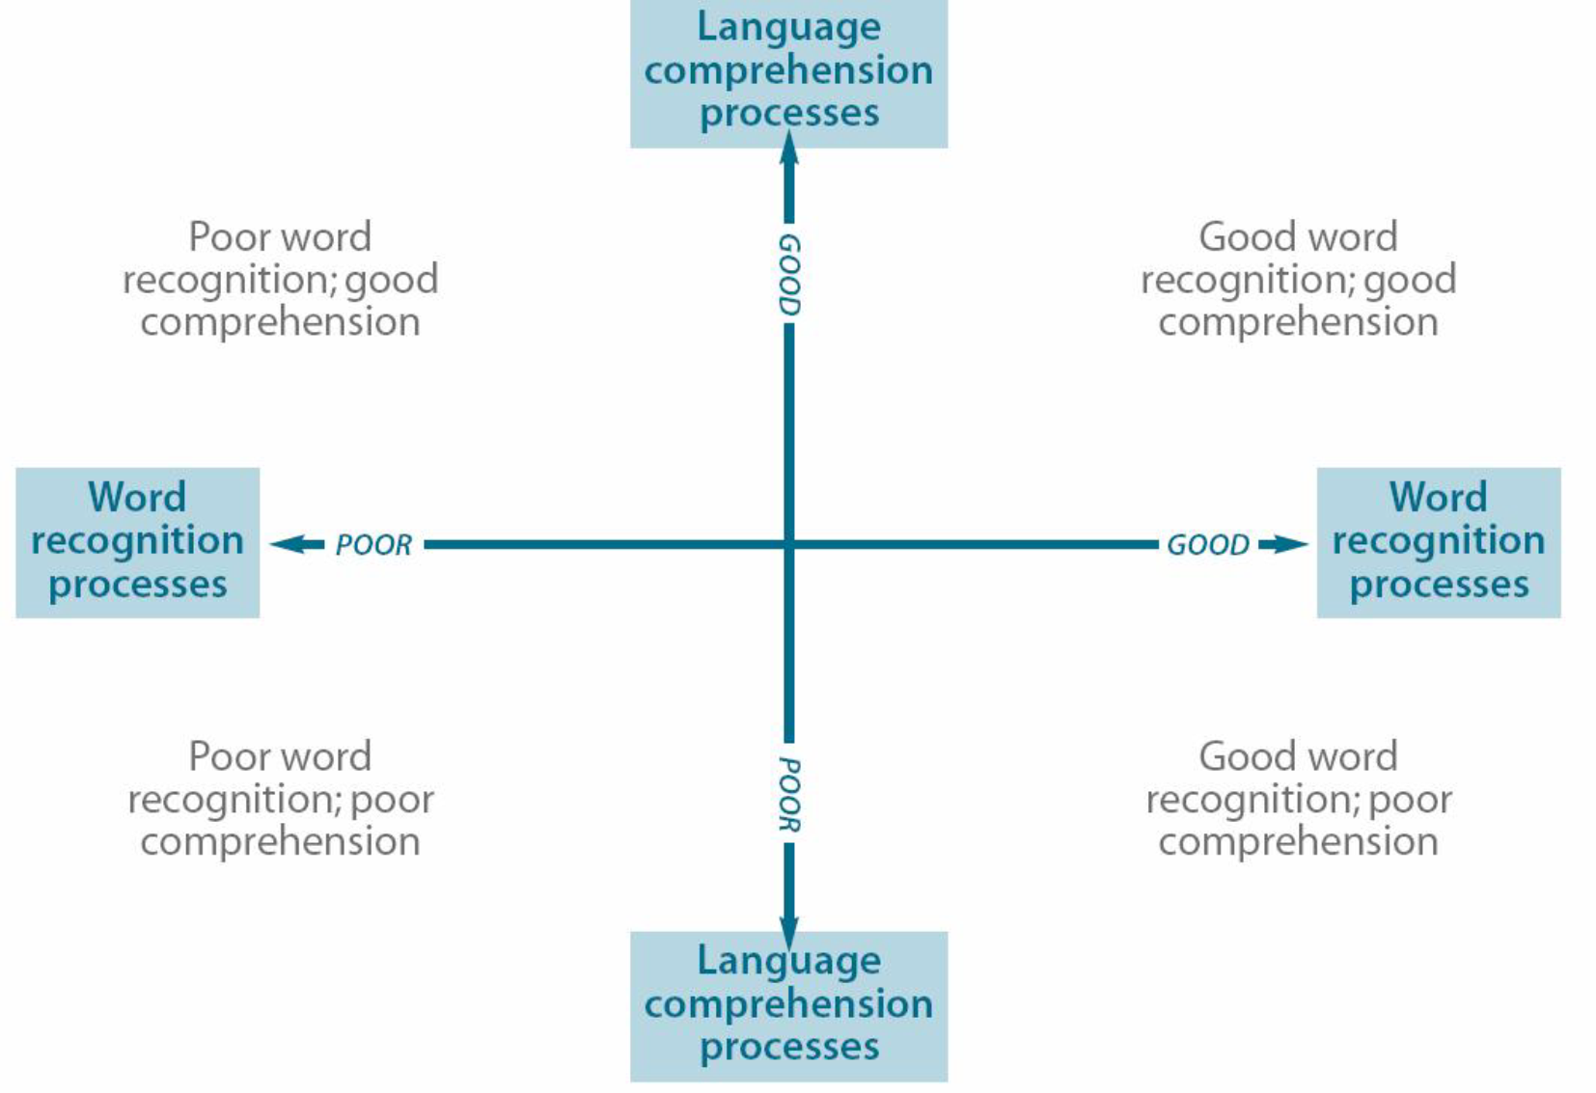
The Importance of Reading
The Independent Review of the Teaching of Early Reading – Jim Rose 2006
The Simple View of Reading:
Notes:
Children need both good language comprehension and good word reading to become good readers.

Slide 3
From the Reading Agency…
Parents are the most important reading role model for children and young people.
There is overwhelming evidence that literacy has a significant relationship to people’s life chances.
Reading for pleasure is more important than either wealth or social class as an indicator of success at school.
Only 40% of England’s 10 year olds have a positive attitude to reading.
As adults in the 21st century, our children will read and write more than at any time in history.

Slide 4
What is Phonics?
Fast paced – introducing a new sound (phoneme) every day whilst reviewing previously learned sounds
The sounds are taught in a set order so that the children are able to blend the sounds to read words very early on.
We introduce a set of tricky words (red words) that are practised daily. These are words that cannot to be entirely segmented using the sounds that they know. These include ‘the, I, you, my etc.

Slide 5

What we do at Mawgan-in-Pydar School…
At Mawgan-in-Pydar School, we follow an approach called Read, Write Inc.
Read Write Inc. Phonics teaches children to read accurately and fluently with good comprehension. They learn to form each letter, spell correctly, and compose their ideas step-by-step.
First children learn one way to read the 40+ sounds and blend these sounds into words, then learn to read the same sounds with alternative graphemes (letters).
Learn to spell using known sounds
Write confidently by saying what they want to write out loud first
At Mawgan-in-Pydar
All staff are Read Write Inc trained.
Assessments are carried out by your child’s teacher every half term.
We split between EYFS- Year 2.
The aim is to ensure children are accurate and speedy readers by the end of Year 1.

Slide 6
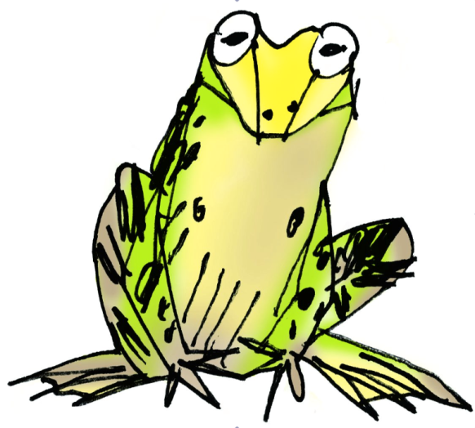
How does phonics help us to read?
Say “hello” to Fred.
Fred can only talk in sounds...
He says “c_a_t.” Not cat.
We call this Fred Talk.
The importance of talk for writing
“What you can say today...you can write tomorrow”
Ruth Misken
Notes:
SHOW FRED TOY

Slide 7
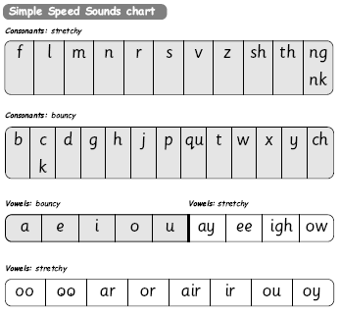
The Speed Sounds
Special friends...2 letters that make 1 sound.

Slide 8
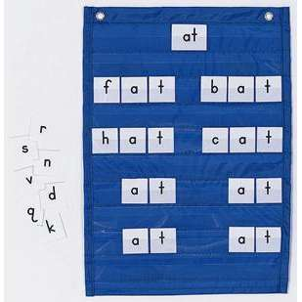
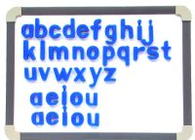

Learning to blend and segment with the sounds we know…
Assisted blending
as soon as the first 5
sounds are learnt!
Moving towards
independent
blending
Fred Fingers for spelling
*Say the word and
pinch on the sounds
Eyes for reading,
fingers for spelling!
a
c
t

Slide 9


Learning to blend and segment with the sounds we know…
Green words – contain all the sounds we know
*Fred talk
*Fred in your head
*No Fred talk
Red words
‘You can’t Fred a red.’

Slide 10

Early blending.
Reading can happen anywhere.
Be creative!
Make it fun!

Slide 11
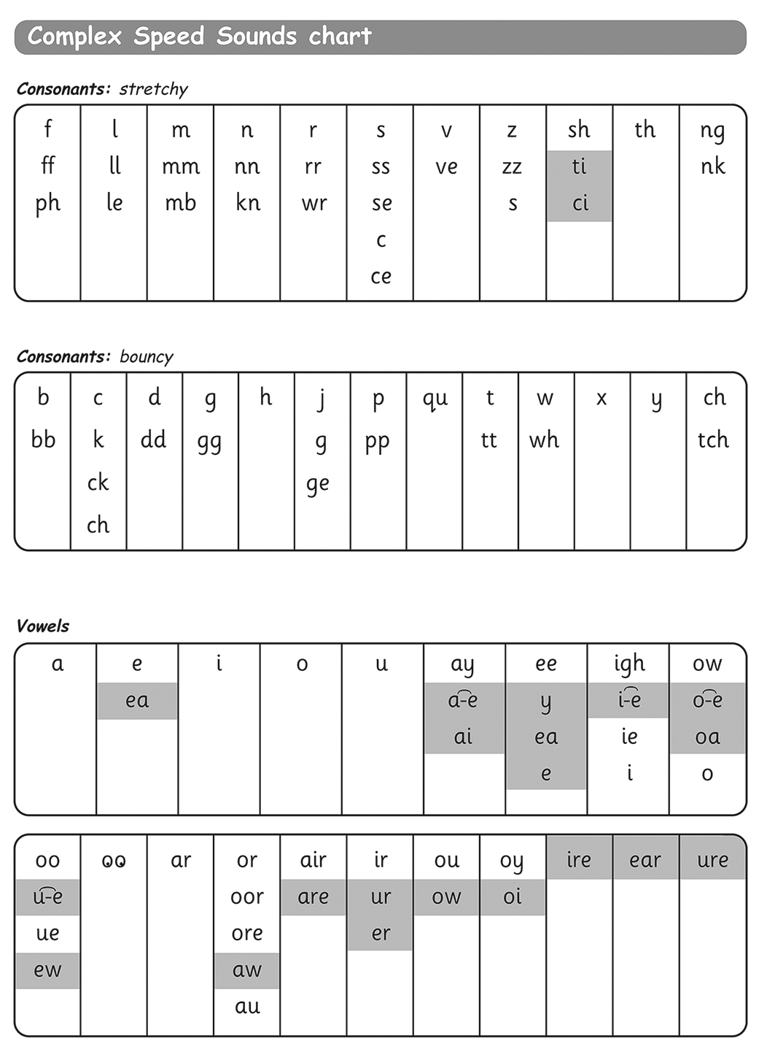
When children are confident with set 1 and 2 sounds, they move onto Set 3.
Set 3 sounds
Split digraphs.

Slide 12
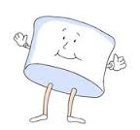

RWI techniques…some of the things you may hear about!
Praise, praise praise…
1, 2, 3 well done me!
A round of a claws.
Marshmallow clap.
Firework
Positivity and passion…
All of us want all of the children to do very well, to enjoy and to achieve!
Participation…
MTYT
TTYP
Fred fingers
Magic pens – what colour ink

Slide 13
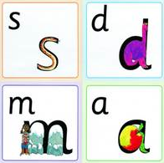
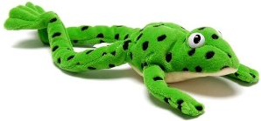
Reading at home
Read favourite stories over and over again.
Promote a love of books.
Make time to share stories regularly.
Book talk – comprehension and imagination (What has happened, what might happen next and why?)
Discuss the story together – what did you like about the book? What was your favourite part?
Watch the RWI Storytime at home video for hints and tips.
Practise pronouncing the sounds…
Remember no ‘fuh’ and ‘luh’!
Have fun with Fred Talk!
“What a tidy r-oo-m!”
“Where’s your c-oa-t?”
“Time for b-e-d!”
"Get your sh-oe-s".

Slide 14
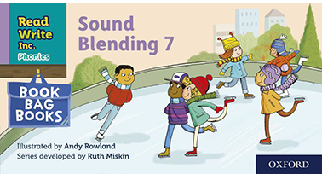
Sound blending books
When your child is ready, they will start to bring home sound blending books.
These include only the sounds your child has learnt.
They will be able to say each sound and by repeating them faster they will orally blend the word.
If they struggle with a sound its okay to help them (use the pure sound).
So your child doesn’t learn by rote, it is a good idea to start at a different page if your child is beginning to become familiar with the pattern of words. Make it fun. Make it rewarding.
We will assess the children in school. Once they are confident with reading these sounds, we will give them a new sound blending book.

Slide 15
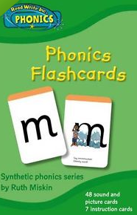
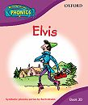

Available resources:
Supporting our reading scheme:
It is not a race through all the sounds…there are many skills involved!
Children need to be exposed to words several times before they become fluent and automatic.
We aim for the children to be able to read as storytellers with the appropriate expression and intonation and therefore understanding.

Slide 16
How can you support your child’s learning at home?
Sound sheets will be sent home weekly. Please practice reading and writing these sounds/ words.
Individual reading books. Record your child’s reading in their reading log. We encourage children to read their book at least twice to encourage fluency. We will read with your child in class at least once a week, on top of daily RWInc sessions. We encourage you to read 5 times a week, even if it is just a page or two. Regular reading time will make all the difference. This will be the ‘homework’ for your child whilst they are in Reception class.
Phonics games and apps – Phonics Play, ICT Games, Phonics Genius, Ladybird I’m Ready for Phonics, Teach your Monster to Read, Hooked on Phonics, Early Reading, Alphablocks
Encourage your child to love reading. Surrounding your child with books and text (comics, magazines, fiction and non-fiction). Read to each other. Visit a local library. Read things all around you – signs, menus, road names, everyday information, shopping lists – make it fun!
Show enthusiasm!

Slide 17
Helpful tips…
Encourage your child to segment and blend words if they know those sounds. Help them to do this by modelling the process.
Help with tricky words to maintain the flow of the story/text.
Discuss what might be happening in the pictures but don’t encourage your child to use the pictures to ‘guess’ what words might be!
Re-read the book so that children can make sense of what they are reading.
Whilst re-reading, demonstrate reading the text from left to right, but try not to point to the text as you read.
Involve the child in the re-reading part by allowing them to join in.

Slide 18
Phonics Screening Check
The phonics screening check will be taken individually by all children in Year 1, in England, from June 2012. It is designed to give teachers and parents, information on how your child is progressing in phonics.
What is the phonic screening check? There will be two sections in this 40-word check and it will assess phonics skills and knowledge learnt through Reception and Year 1. What will it check?
It will check that your son/daughter can:
•Sound out and blend sounds in order to read simple words.
• Read phonically decodable one-syllable and two-syllable words, e.g. cat, sand, windmill.
• Read a selection of nonsense (alien) words.
The check is not about passing or failing but checking appropriate progress is being made. If you child does not reach the threshold, they will re-sit the check the following summer term.

Slide 19
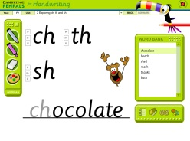

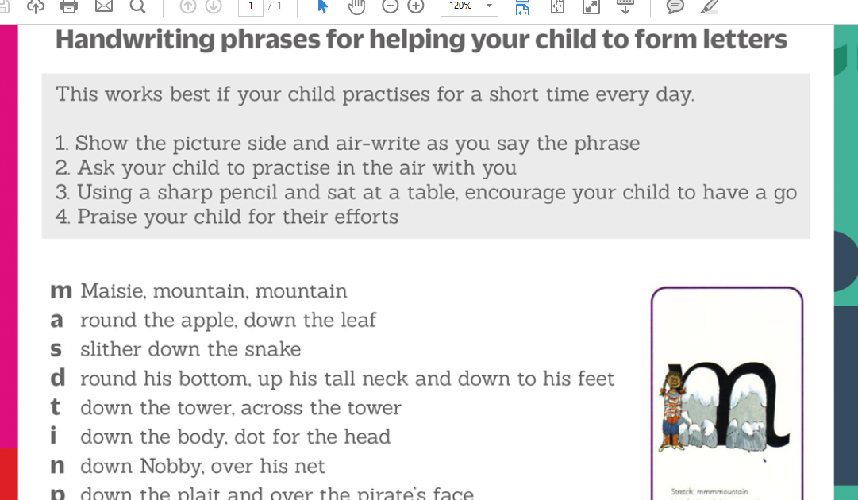
Handwriting
Penpals scheme.
In Early Years the letter shapes are learnt at the same time as the sound.
These are sent home weekly with the appropriate rhyme.
As the children progress, handwriting is a separate lesson in the week as it has always been.

Slide 20

Six skills that children must have before handwriting begins are:
Small muscle development
Eye-hand coordination
ability to hold utensils or writing tools
capacity to smoothly form basic strokes such as lines and circles
letter perception, including the ability to recognize forms, notice likeness and differences, infer the movements necessary for the production of form and give accurate verbal descriptions of what is seen
Orientation to printed language, which involves the visual analysis of letters and words along with right/left discrimination.

Slide 21
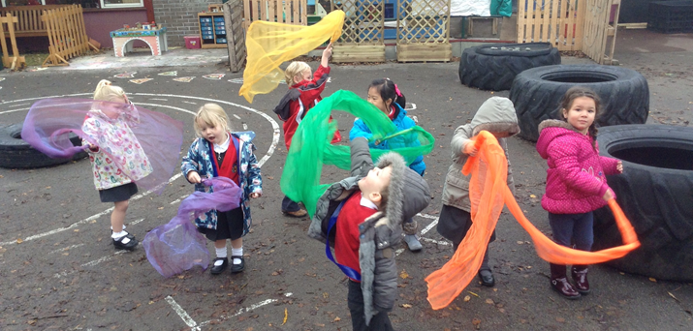
Gross motor control – early stages
Consolidate the vocabulary of movement by talking about the movements children make, such as going round and round, making curves, springing up and sliding down, making long, slow movements or quick, jumpy movements.
Large movements in the air with their arms, hands and shoulders.
Notes:
Dancing with ribbons – use both sides of their body, Dough Disco, Write Dance

Slide 22
What can you do to help?
Provide opportunities for your child to make large movements – chalks on patio, mark making in the sand, painting (water on a brush on a wall or patio) swirl a tea towel/old bits of material
Provide opportunities for your child to make finer, more controlled movements – threading, play dough, cooked spaghetti, mud, finger rhymes
Don’t rush your child to write!
Let your child choose the hand they write with
Make it fun!

Slide 23
Looking after books.
No water bottles in book bags.
Please look after the books. They are expensive. It is important for us to maintain the good quality of the books for subsequent children working their way up through the reading scheme.
Return the books. They part of a set that allows our children and subsequent children. We cannot just replace one book, and the set are very expensive.
Having books that have been looked after helps to promote a love of reading for all children.
Please keep the reading materials in your child’s book bag so that nothing is lost or misplaced.
Thank you for returning the books and your continued help towards your children reading journey.
The key stage one team records all books taken home. The school may charge you for books that are lost or damaged.

Slide 24
Useful links:
Oxford Owl for School and Home
Parents - Ruth Miskin Literacy
PhonicsPlay
Teach Your Monster: Free Phonics, Reading and Mathematics Games

